Slide 1



Accelerating Image Forensics
CSYE 7105 Final Project
With Parallel Computing
Team 9
Kaushik Malikireddy Aditi Deodhar

Slide 2




Introduction
Background
Motivation
for faster,
Project Goal
parallel computing to and differentiate real
The rapid increase of AI- generated images (deepfakes) raising concerns in media, cybersecurity, and ethics and
We need detection exploring (CPU/GPU
real-time
thus,
Utilize analyze from
methods
parallel computing parallelism, multi-
AI-generated images
efficiently, significantly reducing
traditional CNN-based detection | GPU | training, | optimized | training | time and | enabling
methods face accuracy, speed, | pipelines) |  |  | training | of complex | models at
and computational efficiency |  |  |  | scale.
challenges.

Slide 3






Dataset
Source: Shutterstock (real) and
state-of-the-art generative models (AI)
Dataset Size:
Training: ~80,000 images Testing: ~5,500 images Total: ~11.5 GB
Image Resolution: ~700x700 pixels Labels: Real (0) or AI-generated (1)
Real or AI

Slide 4


Methodology
Data Preprocessing
ResNet18:
Images resized to 224×224
Dataset split: ~50k train / 15k val / 15k test.
Vision Transformer (ViT):
Normalized using ViT-specific mean/std. Split: 40k train / 5k val / 5k test.
Custom PyTorch Dataset and DataLoader
Evaluations
Tracked training time, speedup, and efficiency across different configurations. Measured the impact of AMP, DDP, and Model Parallelism.
Compared Model performances ResNet vs ViT

Slide 5

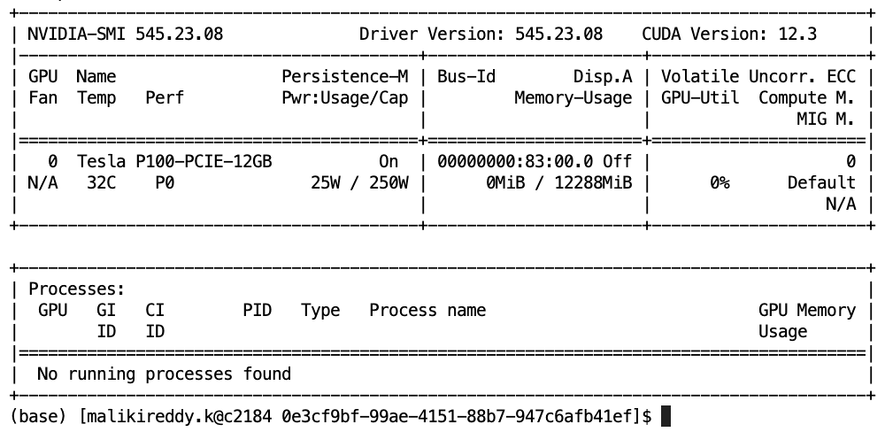
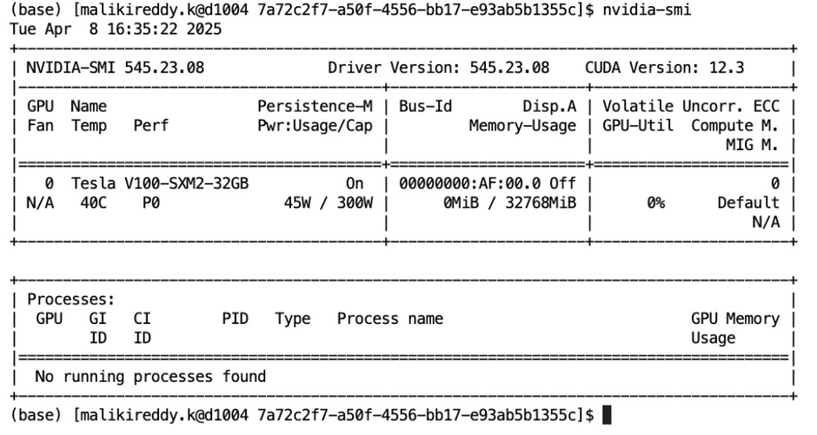

Environment
P100 V100-SXM2
CPUs - 1,2,4,8 || GPUs- 1,2,4 || PyTorch version: 2.5.1+cu121 || Python: 3.11.11

Slide 6
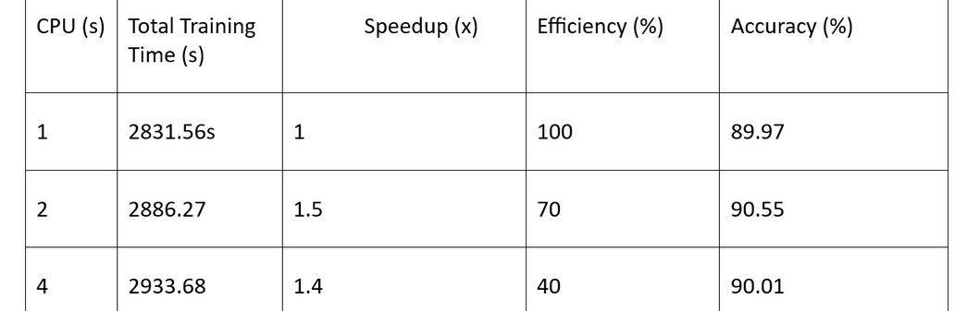
Parallelism In CPU for Model Training
ResNet18
Observations
Accuracy - Stable Speed up - Increases
Synchronization overhead likely reduces gains beyond 2 threads
Conclusion
2 threads is a sweet spot for this workload on CPU
CPU offers limited benefits for deep learning tasks compared to GPU

Slide 7
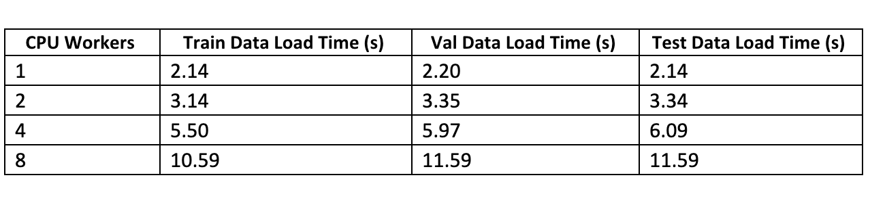
Parallelism In CPU for Data Loading
Vision Transformer
Observations
2 workers is the optimal point, balancing performance and overhead — beyond that, CPU contention and I/O bottlenecks degrade speed.
CPU offers limited advantage for Vision Transformer; GPU acceleration is more effective for significant gains.

Slide 8
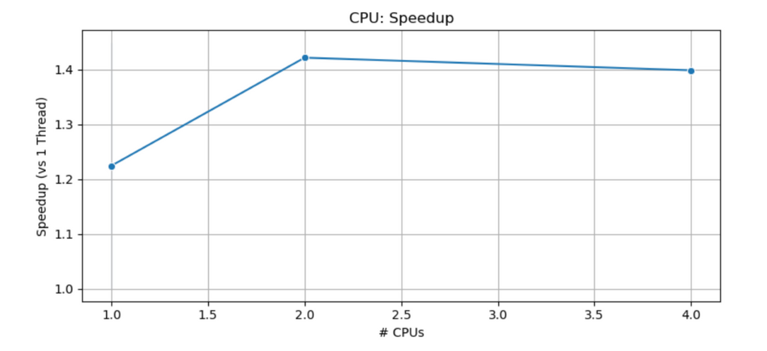
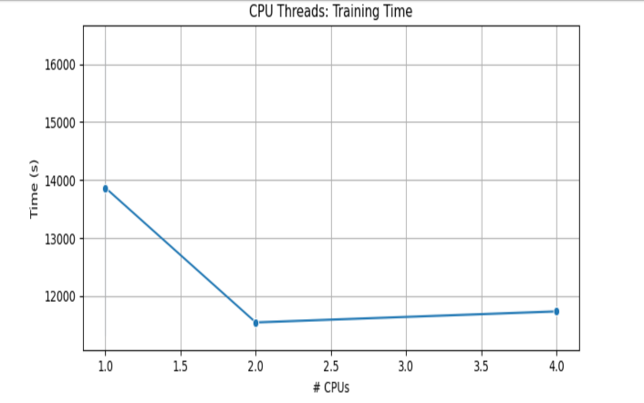
Parallelism In CPU for Model Training
ResNet18

Slide 9
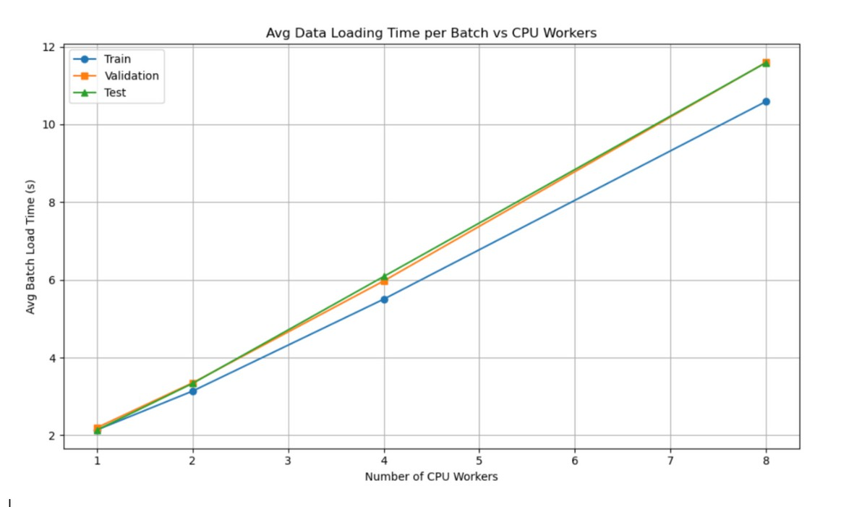
Parallelism In CPU for Data Loading
Vision Transformer
9

Slide 10


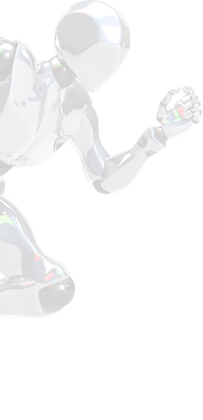
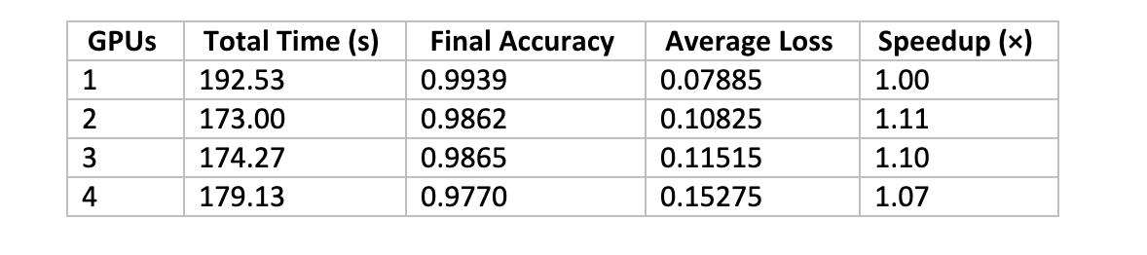
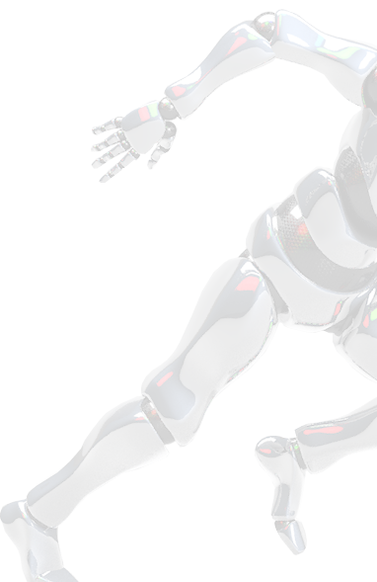
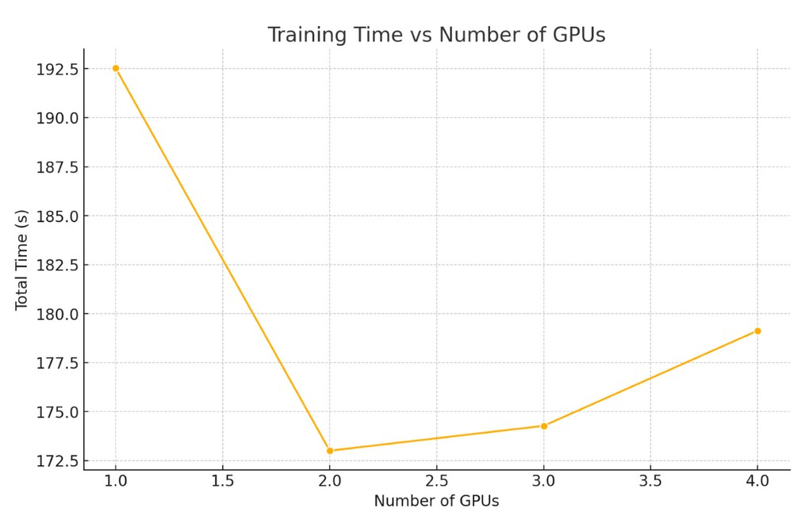

GPU Parallelism (DDP - ResNet)
Observations
Accuracy slightly decreased as GPU count increased
Speedup was sub-linear; gains peaked at 2 GPUs (1.11×) and dropped beyond that due to communication overhead.
Conclusion
DDP provided modest speedup, but benefits plateaued beyond 2 GPUs.
Careful GPU count selection is critical for optimal efficiency
10

Slide 11
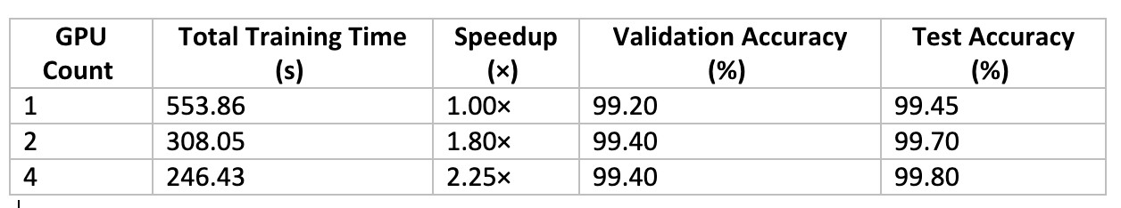
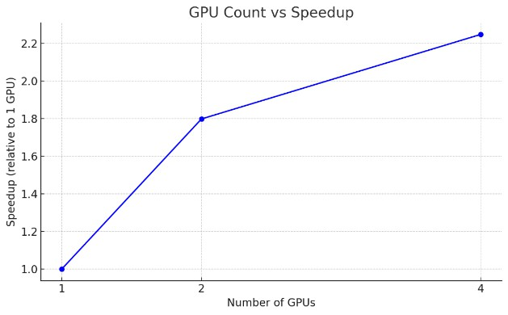
GPU Parallelism (DDP - ViT)
Observations
Accuracy improved slightly as the number of GPUs increased.
Speedup was sub-linear, likely due to inter- GPU communication overhead.
Conclusion
DDP significantly accelerated training and allowed scalable performance for Vision Transformers.
11

Slide 12

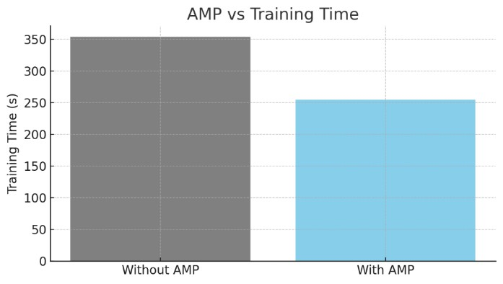
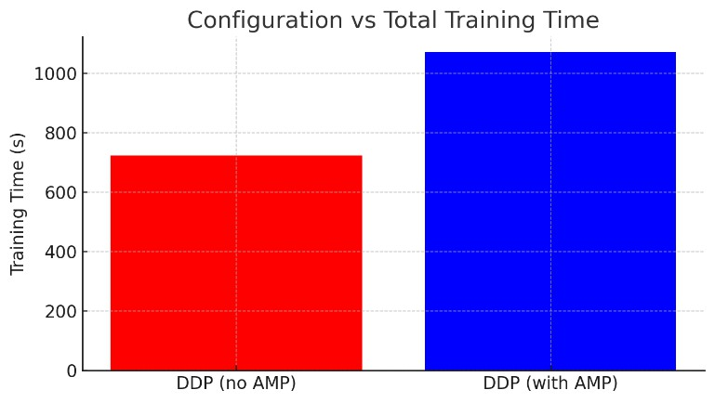

Mixed Precision (AMP) Training
ViT
Reduced Training Time: Training time decreased from
353.76s to 254.92s, a ~28% improvement.
ResNet
Mixed precision moderately increased training times (~18% higher ) compared to traditional 32-bit precision training.
12
V100 GPU

Slide 13



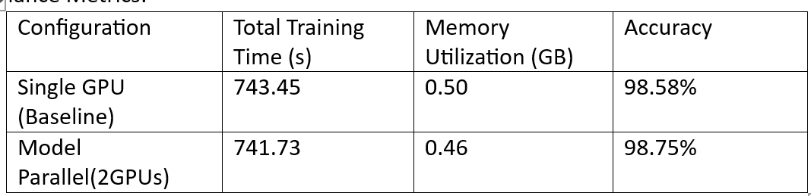
Model Parallelism(ResNet)
Observations
Slight accuracy improvement (+0.17%) Memory usage per GPU reduced by ~8%
Training time almost unchanged due to inter-GPU communication
Conclusion
Model parallelism offers memory efficiency for ResNet18
Limited benefit for small models; DDP or AMP are more effective for performance gains
Note: The ResNet model used was not pre-trained. 5 layers were places on GPU1 G 13 layers on GPU2
13

Slide 14


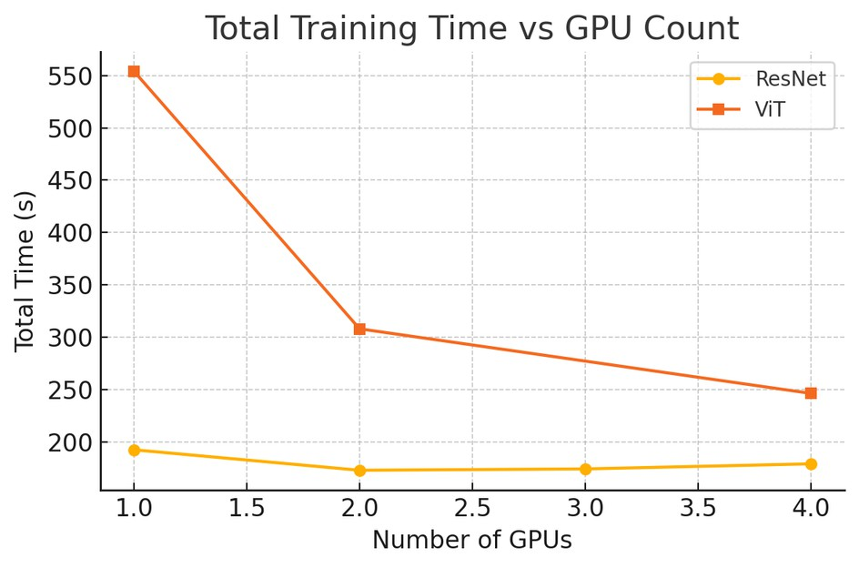
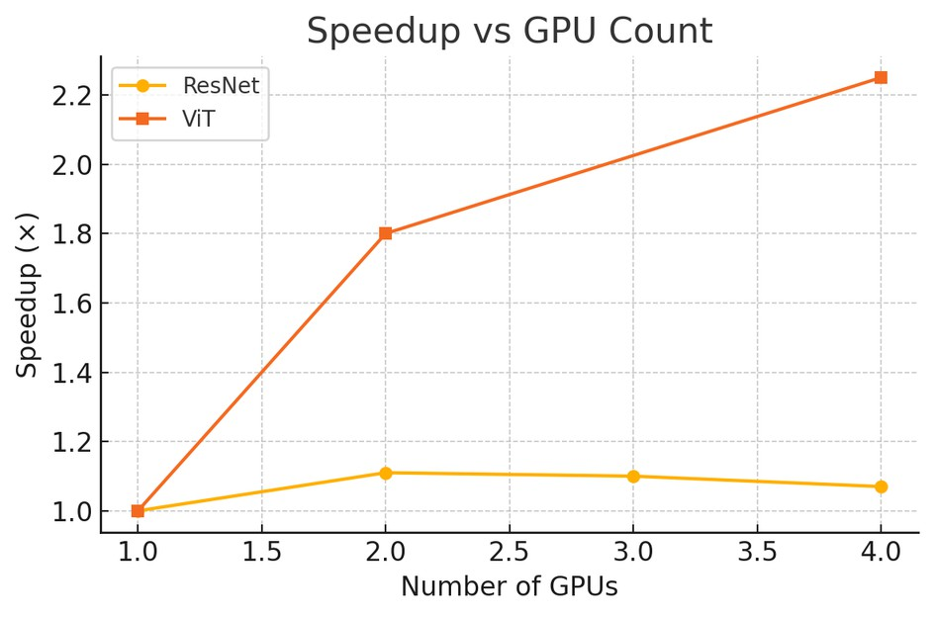
Compare the Models
Observations
ViT scaled significantly better with GPU count, achieving a 2.25× speedup vs ResNet’s peak of 1.11×.
ResNet maintained better accuracy at lower GPU counts, while ViT consistently improved both speed and accuracy with more GPUs.

Slide 15






Conclusion
DataLoader Optimization with CPU
CPU Parallelism has limited benefits
Model Training Optimization with CPU
2 threads gave optimal results; gains diminished beyond that.
GPU DDP (Distributed Training)
ViT scaled efficiently, achieving 2.25× speedup on 4 GPUs. ResNet saw good gains with a 1.11x speed up on 2 GPUs
Mixed Precision (AMP)
Reduced GPU memory usage and improved training time (~18–28%).
Accuracy was preserved or slightly improved.
Model Parallelism
Minor memory gains for ResNet.
Not effective for ViT due to layer dependencies.

Slide 16

References
Krzemińska, J. (2023, October 20). AI vs Human: Can You Tell If This Was Written by AI? Tidio Blog. https://www.tidio.com/blog/ai-test/
Vintila, I. C., Bacha, A., Elouardi, A., fi Elouardi, A. (2024, January 16). Human vs AI-Generated Images: Analysis of Quality and Reliability in the Context of Fake News Detection. arXiv preprint. https://arxiv.org/abs/24 12.09715
PyTorch. (n.d.). Documentation. https://pytorch.org/docs/stable/index.html
Wolfe, C. R. (2021). Vision Transformers. Retrieved from https://cameronrwolfe.substack.com/p/vision- transformers
[Muhammad Fahad et al.]. (2024). Advanced deepfake detection with enhanced ResNet-18 and multilayer CNN max pooling. The Visual Computer. https://link.springer.com/article/10.1007/s00371-024 - 03 613 -x

Slide 17
THANK YOU!

